Slide 1
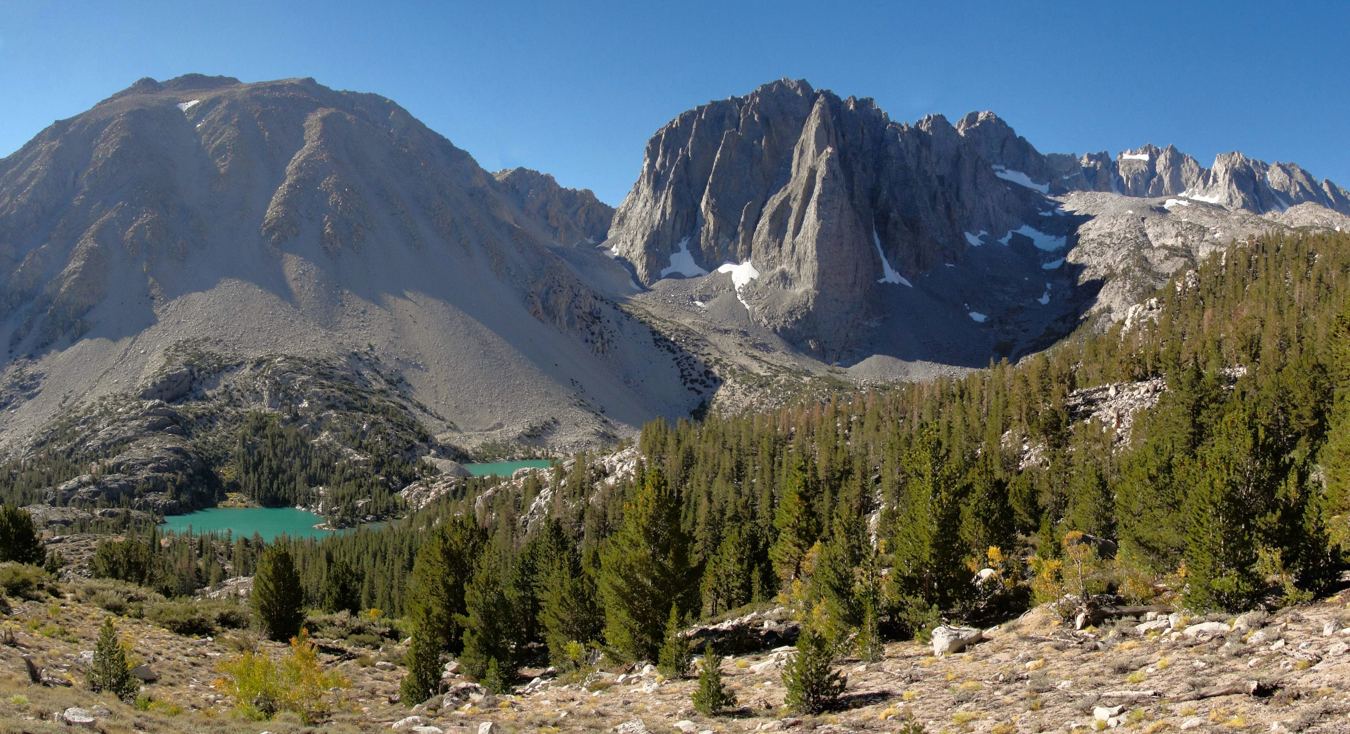
How important are interspecific interactions in shaping patterns of tree species occurrence across spatial scales?
Katie Renwick, Diego Sotomayor, Chris Trisos,
Jenn Weaver, Lynn Sweet, Megan Jennings, Julia Buck

Slide 2
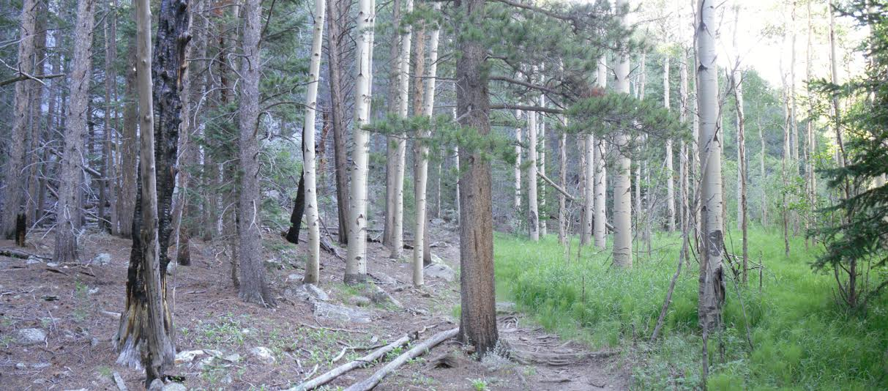
Understanding the factors that determine current plant species distributions is critical if we are to forecast how forest composition may change in the future.

Slide 3
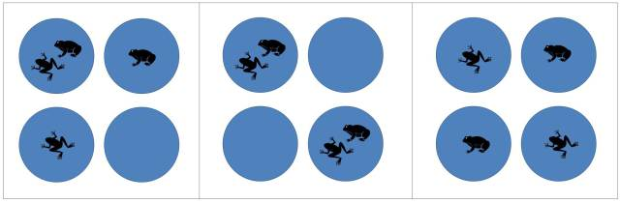
Species distributions
No association
Positive association
Negative association
Notes:
Species can be associated in their patterns of occurrence. Left is independent. Middle is always together. And right is exclude each other. Intermediate levels of correlation lie between these extremes of association. So we need a way to model this co-occurrence.

Slide 4
Species distributions
Environmental factors
Biotic interactions

Slide 5
Species distributions
Traditional species distribution models
Environmental factors
Biotic interactions

Slide 6
Species distributions
Our species distribution model
Environmental factors
Biotic interactions

Slide 7

How?
Trait 2
Trait 1

Slide 8
+
Residual correlation
Trait distance
-

Slide 9
Hypothesis 1: Environmental factors are the primary determinant of species occurrence.
+
Residual correlation
Trait distance
-

Slide 10
Hypothesis 2: Species interactions are the primary determinant of species occurrence.
+
Residual correlation
Trait distance
-

Slide 11
The importance of spatial scale
+
Residual correlation
Trait distance
-

Slide 12
The importance of spatial scale
Small plot
+
Large plot
Residual correlation
Trait distance
-

Slide 15
Data Tables
Plot Data
Species Presence/Absence
Plot area
Plot location
Environmental variables
Climate (temp, precip)
Soil
Fire
Management unit
Species Traits
Growth form
Specific leaf area
Wood density
Leaf C mass
Leaf N mass

Slide 16
Data sources
Plot Data
National Park Service Vegetation plots
-SEKI
-YOSE
USFS plots
California Native Plant Society Plots
Pacific Crest Trail Plots
Potter
Environmental variables
Moisture deficit: Climate WNA
Temperature: Climate WNA
Soil: SSURGO
State fire history: FRAP
Management unit: CPAD
Species Traits
The Botanical Information and Ecology Network (BIEN):
NCEAS and the iPlant Collaborative.
TRY Plant Trait Database
Max Planck Institute for Biogeochemistry

Slide 17
Analysis
Data Sources
Data Compilation and Standardization
Joint SDM
in R
Plant Trait
Data
Several
Sources
Tree occurrence and
environmental data
SQL
database
Data
cleaning
in R
Residual
correlations
Tree functional
trait data
Regression
in R
Forest
Plot Data:
Many
Sources
Environmental
Data:
SSURGO Soils
Climate WNA
Other
Code
Detecting competition
Code
Code
Results
Detect competitive exclusion in Sierran tree assemblages using JSDM approach coupled with functional trait data
Products
Paper
In Science
R Code on
Github
Derived data (maps,
parameters) in DataOne
Evaluate importance of scale in detecting competition

Slide 18
Results Teaser

Slide 19
Next steps
Workplan and Timeline
Finish getting data (by early September)
Run JSDMs (October 1st)
Get trait data (October 1st)
Regression on correlations/traits (end of October)
Start writing introduction (by end of October)
Outline manuscript/decide on figures and tables, make plan (end of November)

